Slide 1
Porites – Shikine – OA Turf Algae
Acropora – Shikine – OA Turf Algae

Slide 2
Porites – Shikine – Pr Turf Algae
Acropora – Shikine – Pr Turf Algae

Slide 3
Porites – Shikine – OA Coral
Acropora – Shikine – OA Coral

Slide 4
Porites – Shikine – Pr Coral
Acropora – Shikine – Pr Coral

Slide 5
Porites – Shikine – OA Turf Algae
Acropora – Shikine – OA Turf Algae
Porites – Shikine – Pr Turf Algae
Acropora – Shikine – Pr Turf Algae
Acropora
Porites
Pr
OA
Pr
OA

Slide 6
Porites – Shikine – OA Turf Algae
Porites – Shikine – OA Turf Algae
Acropora – Shikine – OA Turf Algae

Slide 7
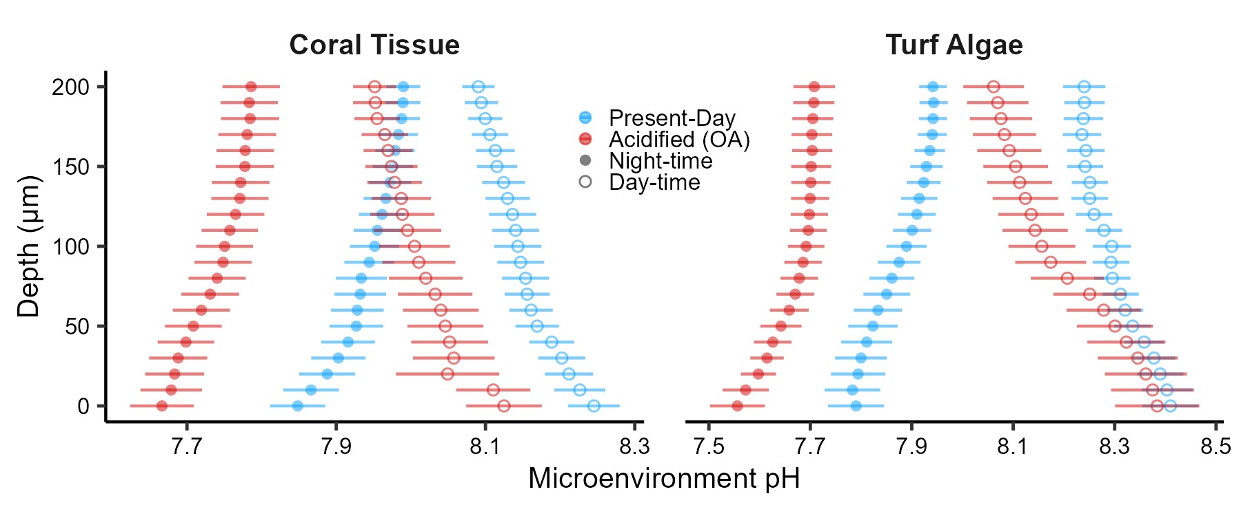
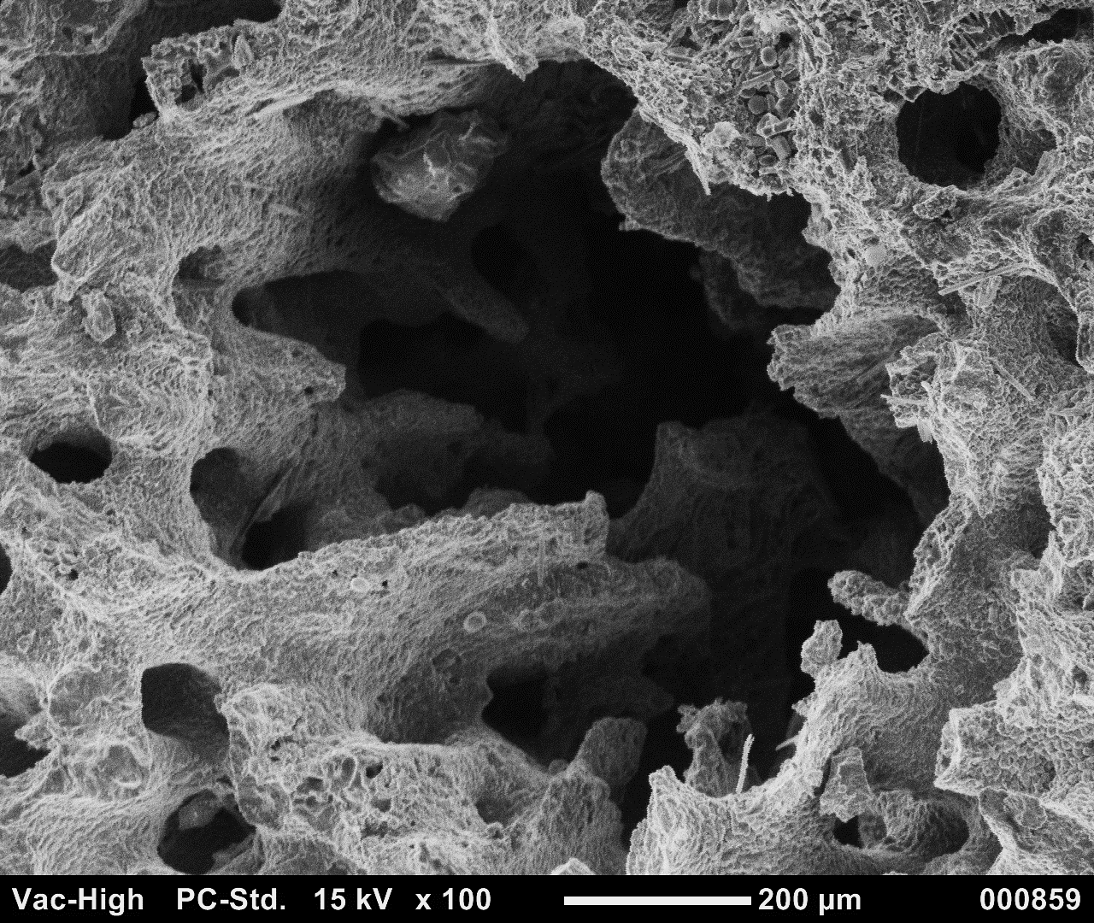
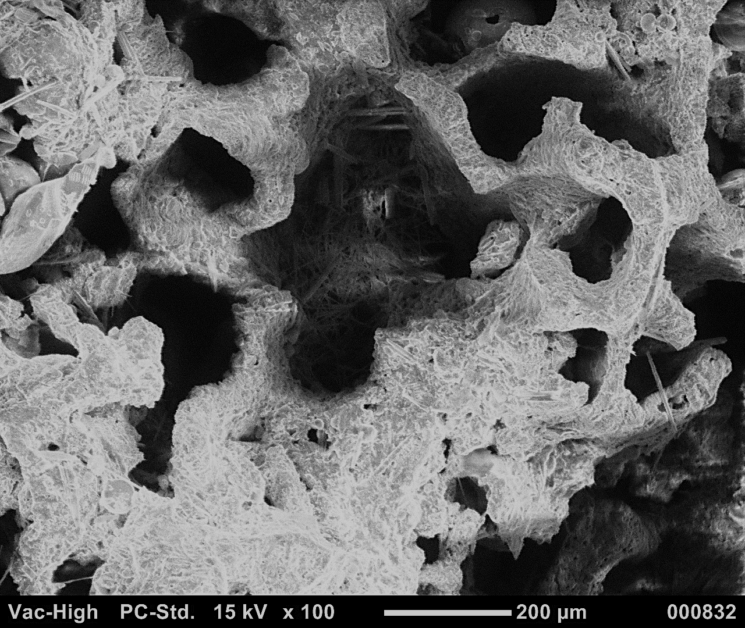
OA Acropora Turf Algae
OA Porites Turf Algae
AD
AN

Slide 8
Acropora Turf Algae
Porites Turf Algae
OA
Pr
OA
Pr
AD
AN
AD

Slide 9
Acropora – Shimoda –Coral
Acropora – Shimoda –Turf Algae

Slide 12
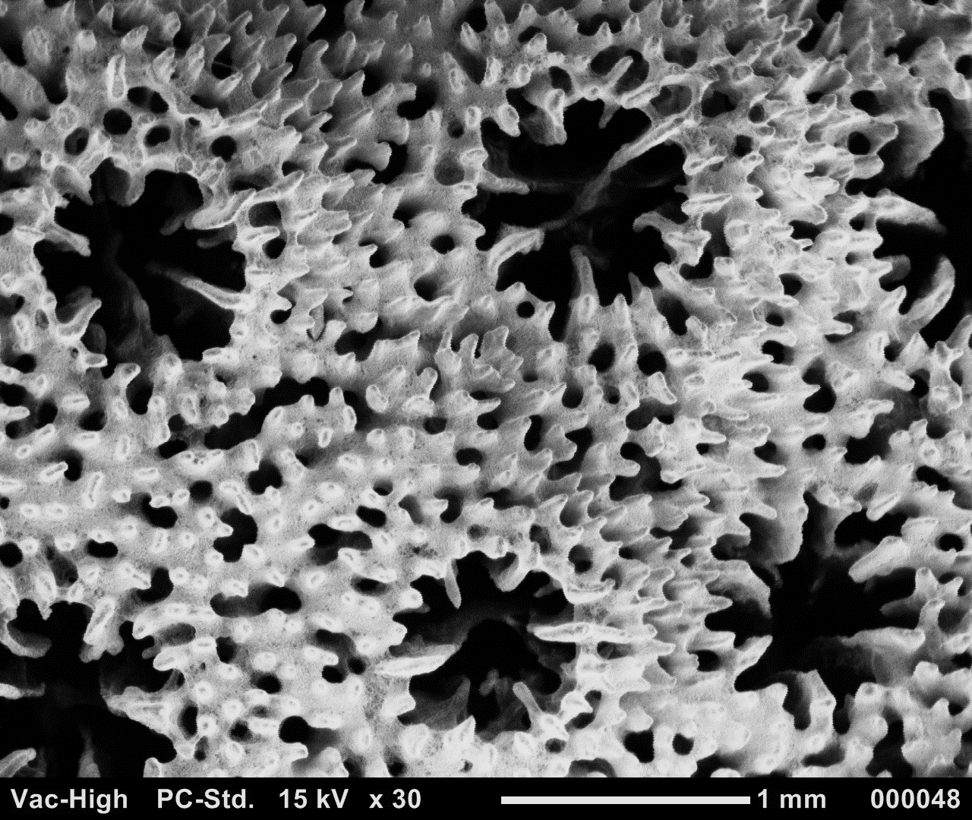
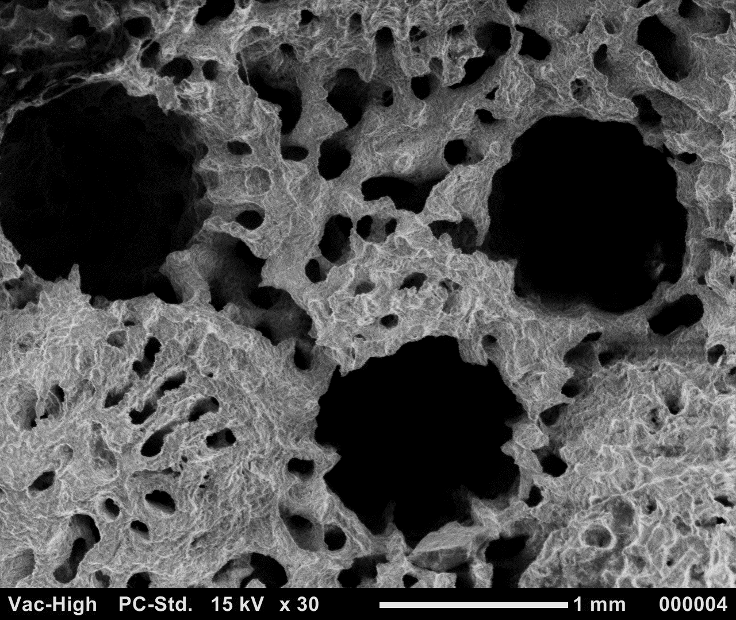
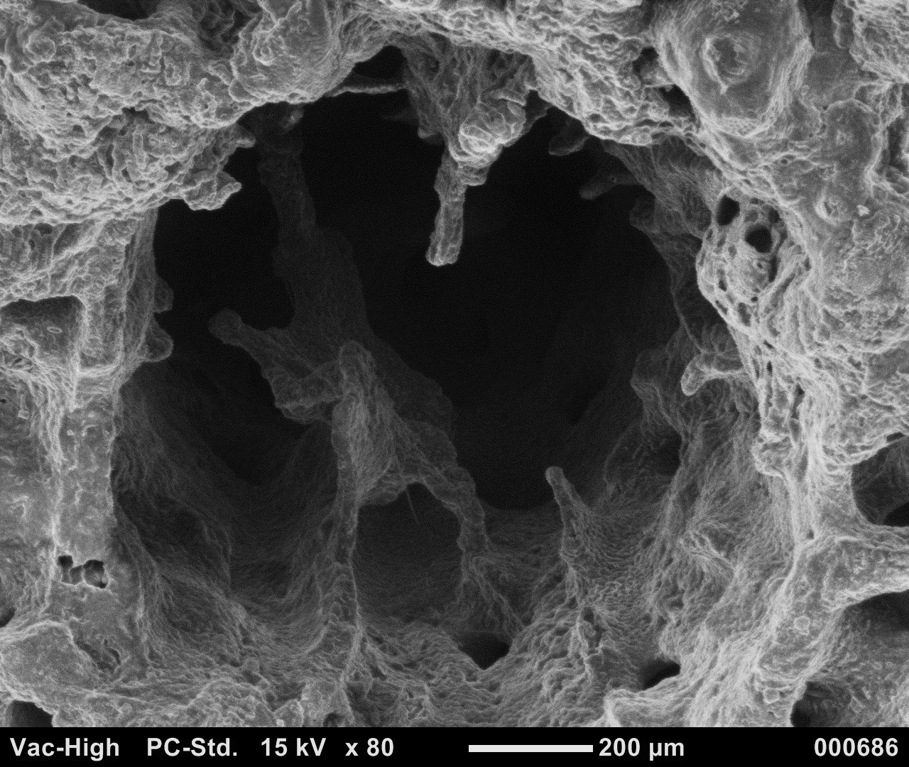
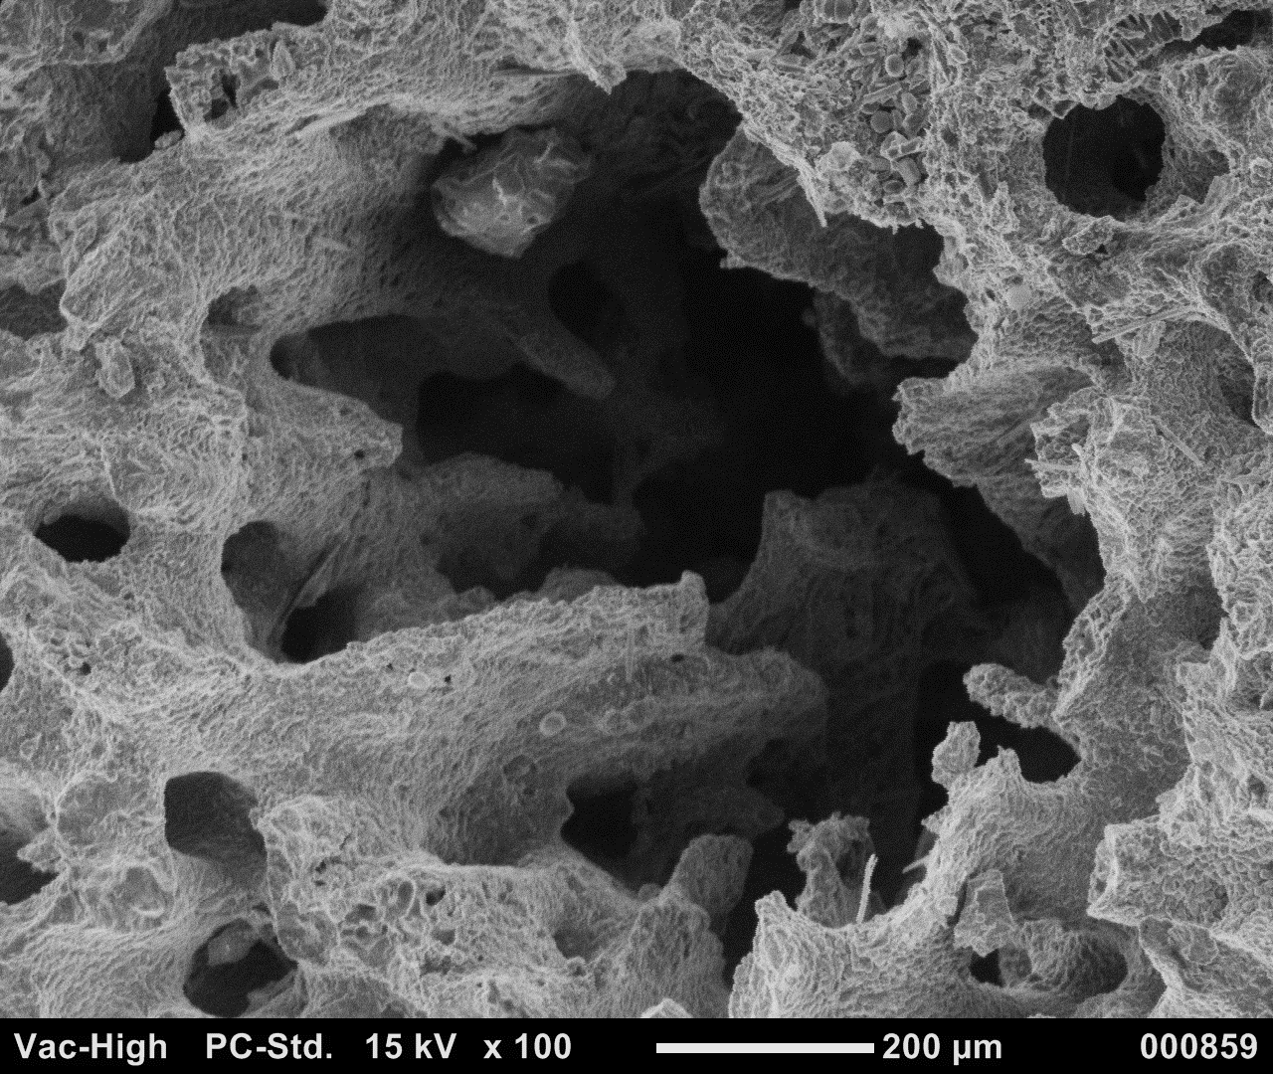
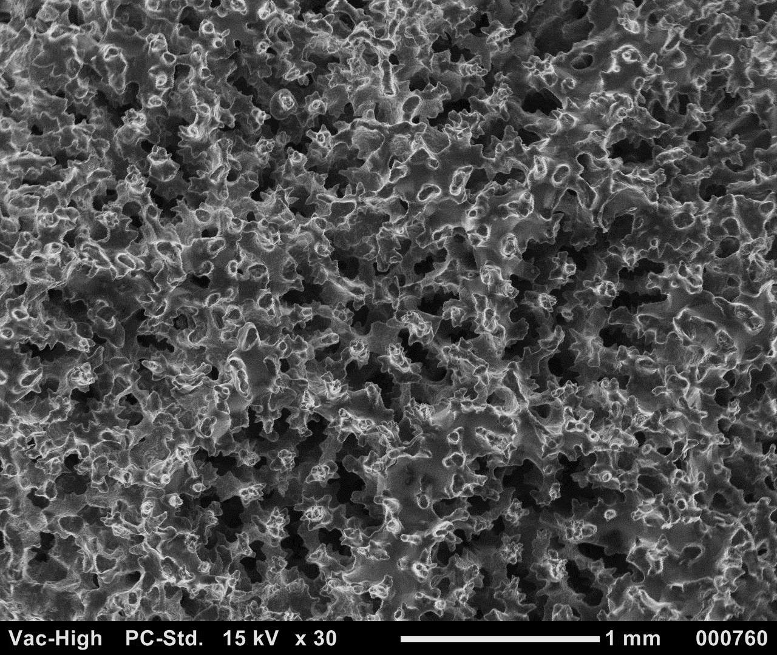
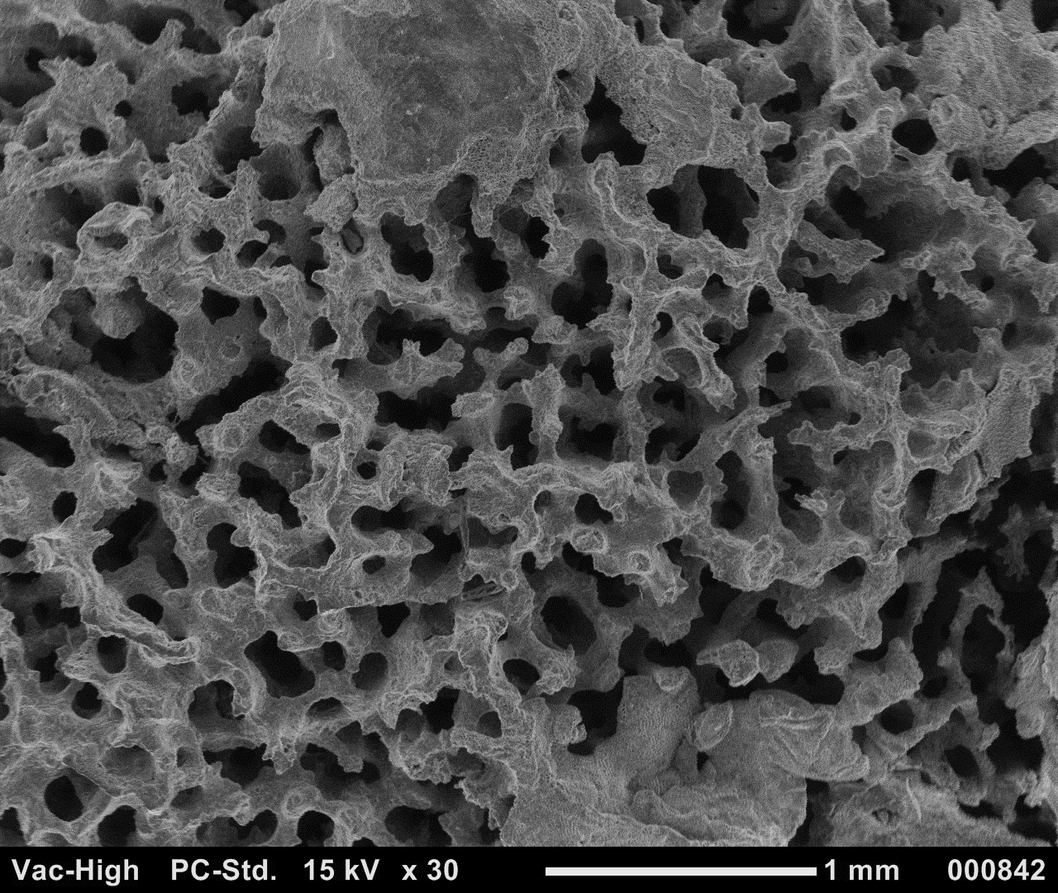
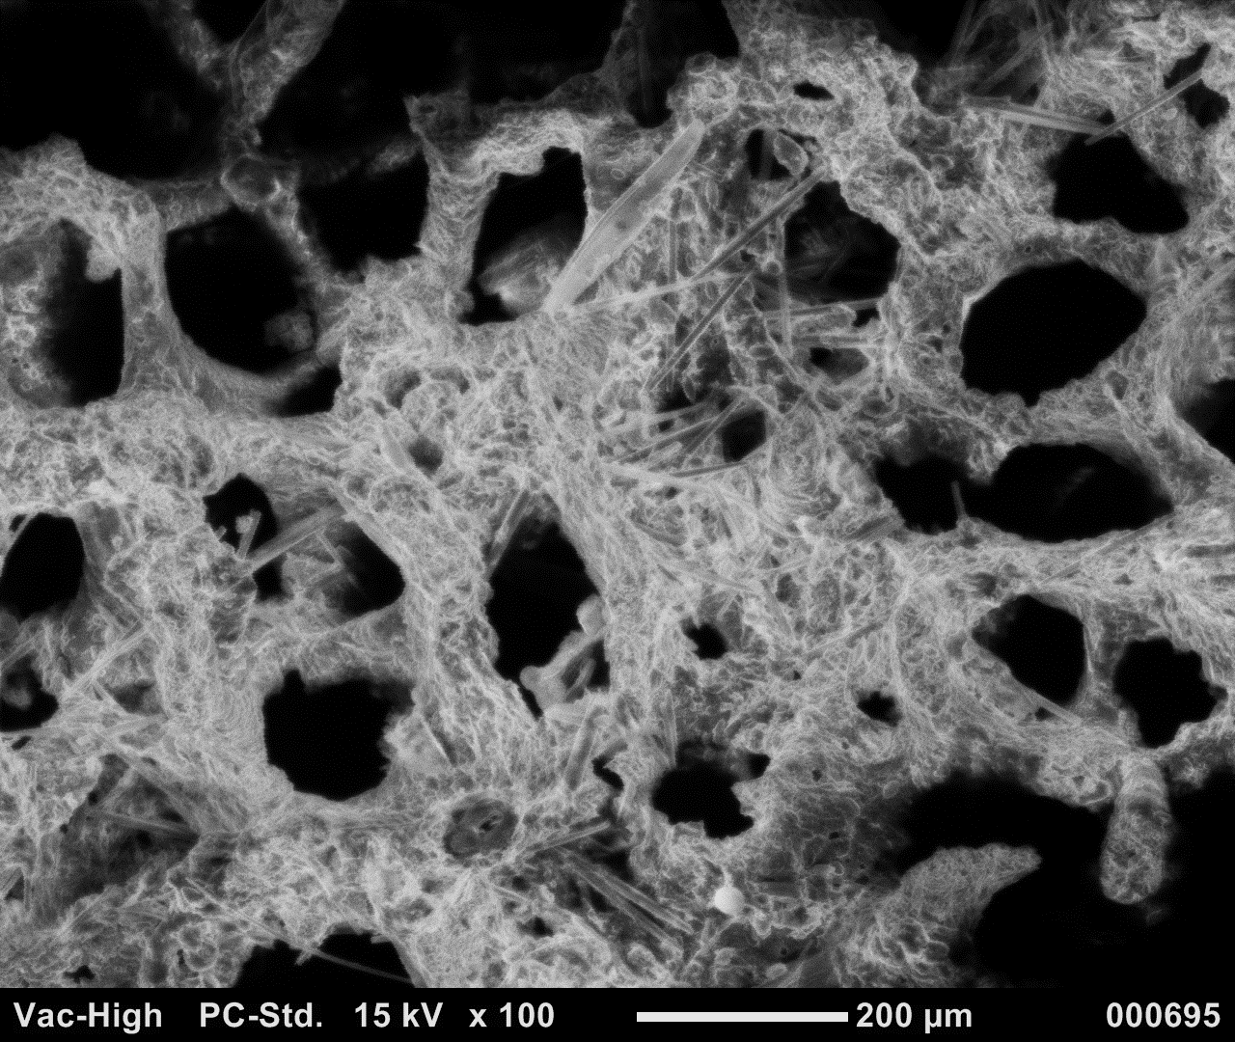
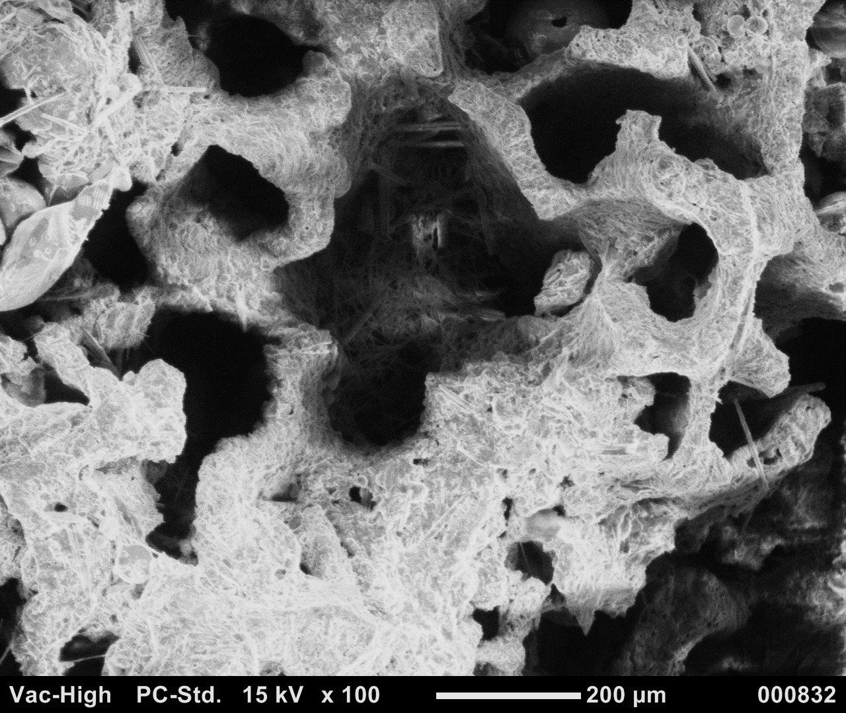
Coral Tissue (OA)
Turf Algae (OA)
Turf Algae (OA) – close-up view
B
pristine corallite
C
D
skeletal micropores
E
potential
calcite deposits
decoration loss
degraded septa
decorated coenosteum
dissepiment
Acropora
septa loss
theca
degraded coenosteum
dissepiments
Corallite wall protrusions
theca loss
septa
F
G
H
potential
calcite
deposits
I
pristine corallite
dissepiment
skeletal amalgam
decorated coenosteum
Porites
degraded corallite
dissepiments
aragonite needles
aragonite needles
decoration loss

Slide 13
PC: Pristine corallite
DCC: Decorated coenosteum
T: Theca
S: Septa
DL: Decoration loss
DGC: Degraded coenosteum
SDL: Septa degradation/loss
TL: Theca loss
D: Dissepiment
DCO: Degraded corallite
SA: Skeletal amalgam
SM: Skeletal micropores
AN: Aragonite needles
PCD: Potential calcite deposits
P: Protrusions
Coral Tissue (OA)
Turf Algae (OA)
Turf Algae (OA) – close-up view
B
PC
C
DL
D
E
SM
PCD
SDL
DCC
D
SDL
Acropora
T
DGC
D
P
TL
S
F
G
H
I
SA
PCD
PC
D
DCC
DCO
Porites
D
AN
AN
DL

Slide 14
A
Coral Tissue (OA)
Turf Algae (OA)
Turf Algae (OA) – close-up view
B
pristine corallite
C
D
skeletal cavities
E
decoration loss
decorated coenosteum
skeletal cavities
thin trabeculae
corallite wall protrusions
mineral deposits
Acropora
theca
degraded coenosteum
degraded septa
theca loss
septa
septa loss
F
G
H
I
pristine corallite
skeletal amalgam
decorated coenosteum
Porites
degraded corallite
thin trabeculae
uneven surface
aragonite needles
aragonite needles
decoration loss

Slide 15
A
PC: Pristine corallite
DCC: Decorated coenosteum
T: Theca
S: Septa
DL: Decoration loss
DGC: Degraded coenosteum
SDL: Septa degradation/loss
TL: Theca loss
D: Dissepiment
DCO: Degraded corallite
SA: Skeletal amalgam
SM: Skeletal micropores
AN: Aragonite needles
PCD: Potential calcite deposits
P: Protrusions
Coral Tissue (OA)
Turf Algae (OA)
Turf Algae (OA) – close-up view
B
PC
C
DL
D
E
SM
PCD
SDL
DCC
D
SDL
Acropora
T
DGC
D
P
TL
S
F
G
H
I
SA
PCD
PC
D
DCC
DCO
Porites
D
AN
AN
DL

Slide 16
A
Coral Tissue (OA)
Turf Algae (OA)
Turf Algae (OA) – close-up view
B
pristine corallite
C
D
skeletal cavities
E
decoration loss
decorated coenosteum
skeletal cavities
thin trabeculae
corallite wall protrusions
mineral deposits
Acropora
theca
degraded coenosteum
degraded septa
theca loss
septa
septa loss
F
G
H
I
pristine corallite
skeletal amalgam
decorated coenosteum
Porites
degraded corallite
thin trabeculae
uneven surface
aragonite needles
aragonite needles
decoration loss

Slide 17
A
PC: Pristine corallite
DCC: Decorated coenosteum
T: Theca
S: Septa
DL: Decoration loss
DGC: Degraded coenosteum
SDL: Septa degradation/loss
TL: Theca loss
D: Dissepiment
DCO: Degraded corallite
SA: Skeletal amalgam
SM: Skeletal micropores
AN: Aragonite needles
PCD: Potential calcite deposits
P: Protrusions
Coral Tissue (OA)
Turf Algae (OA)
Turf Algae (OA) – close-up view
B
PC
C
DL
D
E
SM
PCD
SDL
DCC
D
SDL
Acropora
T
DGC
D
P
TL
S
F
G
H
I
SA
PCD
PC
D
DCC
DCO
Porites
D
AN
AN
DL

Slide 18
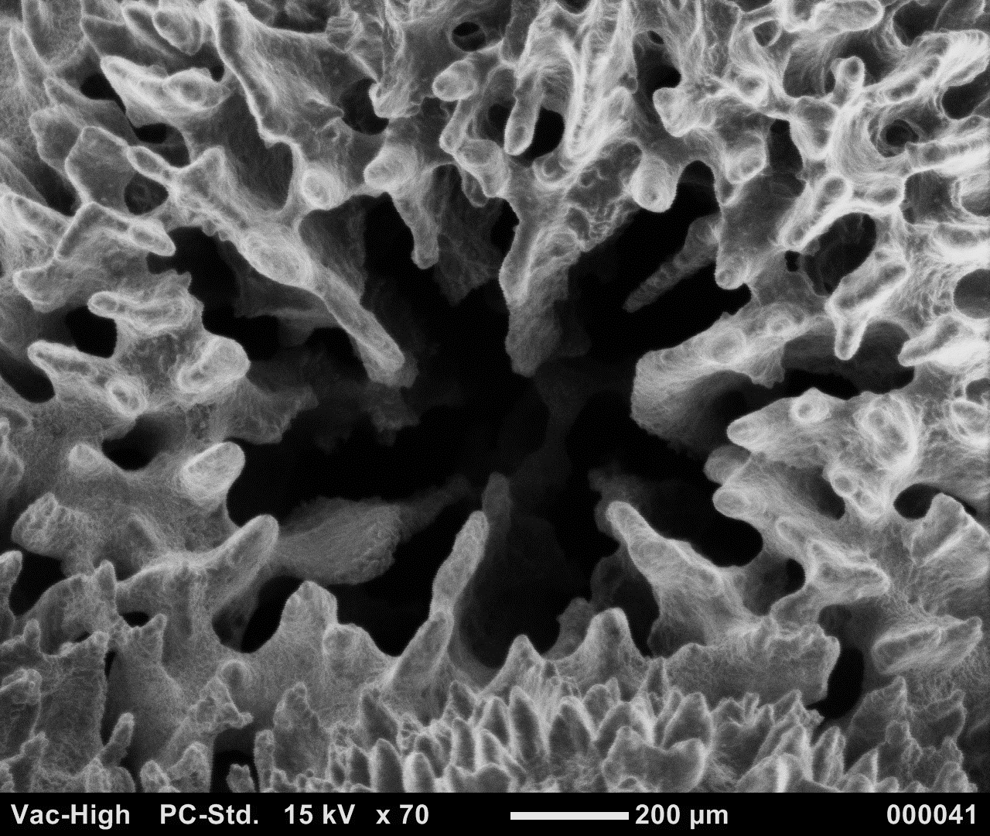
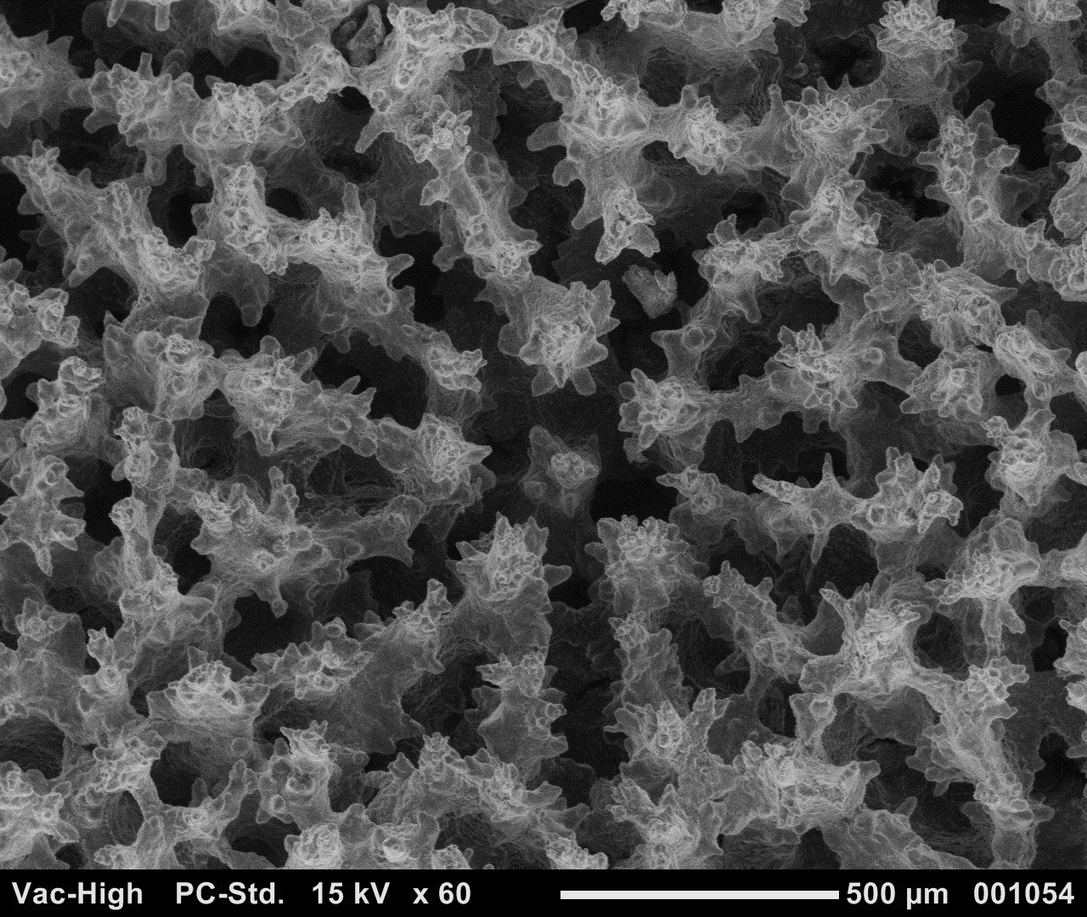
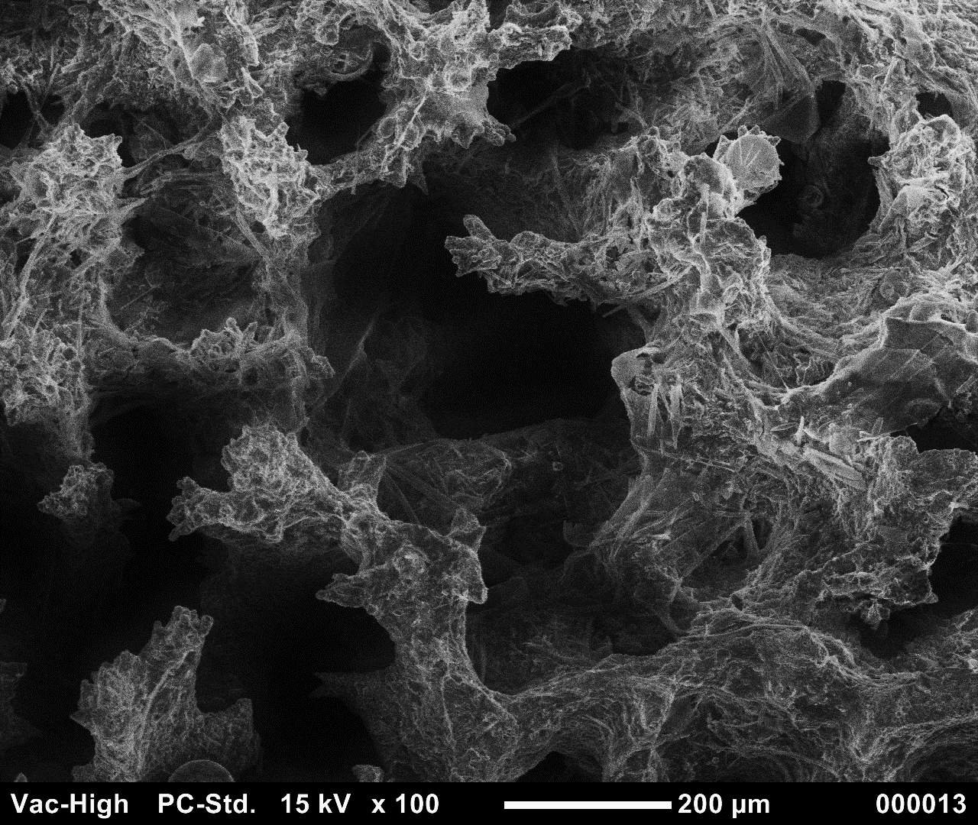
A
Coral Tissue (OA)
Turf Algae (OA)
B
pristine corallite
C
D
E
skeletal cavities
decoration loss
decorated coenosteum
thin trabeculae
Acropora
theca
degraded coenosteum
degraded septa
theca loss
septa
septa loss
F
G
H
I
pristine corallite
skeletal amalgam
decorated coenosteum
Porites
degraded corallite
thin trabeculae
uneven surface
aragonite needles
aragonite needles
decoration loss

Slide 19
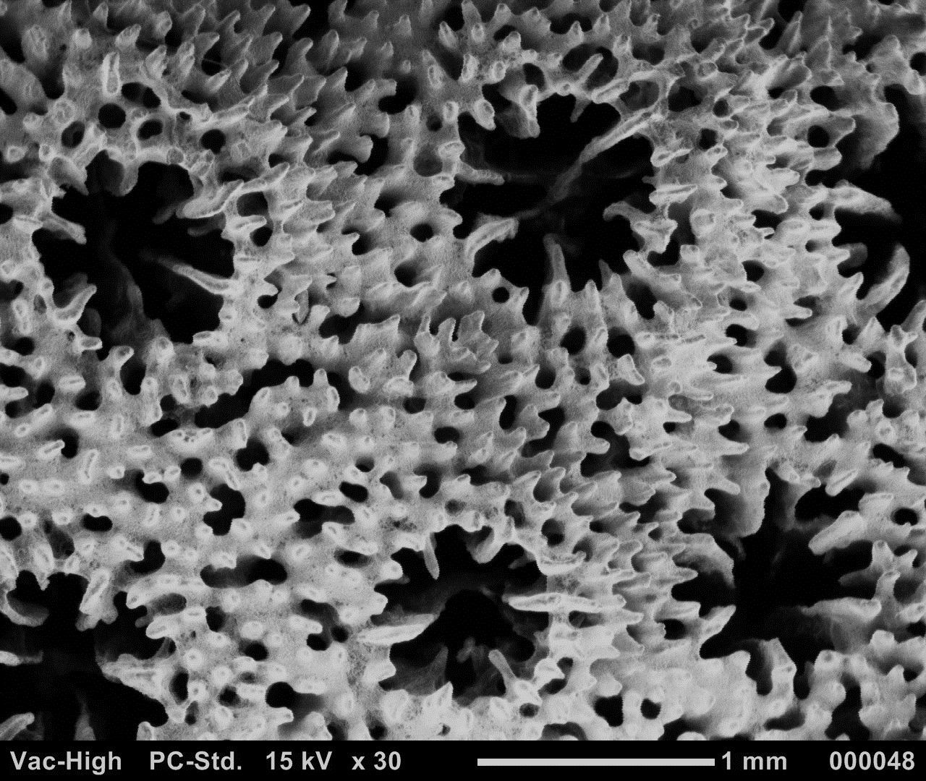
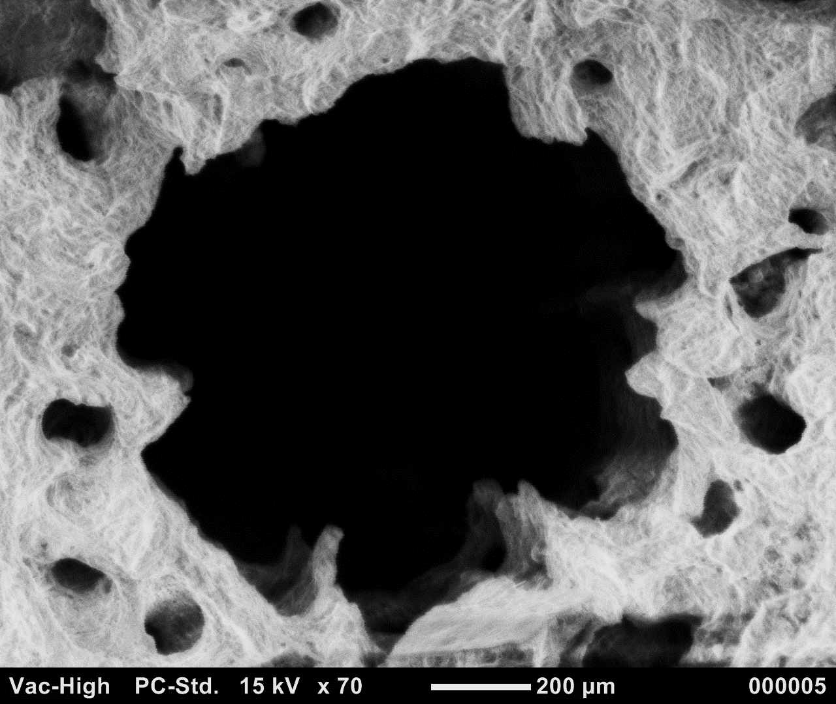

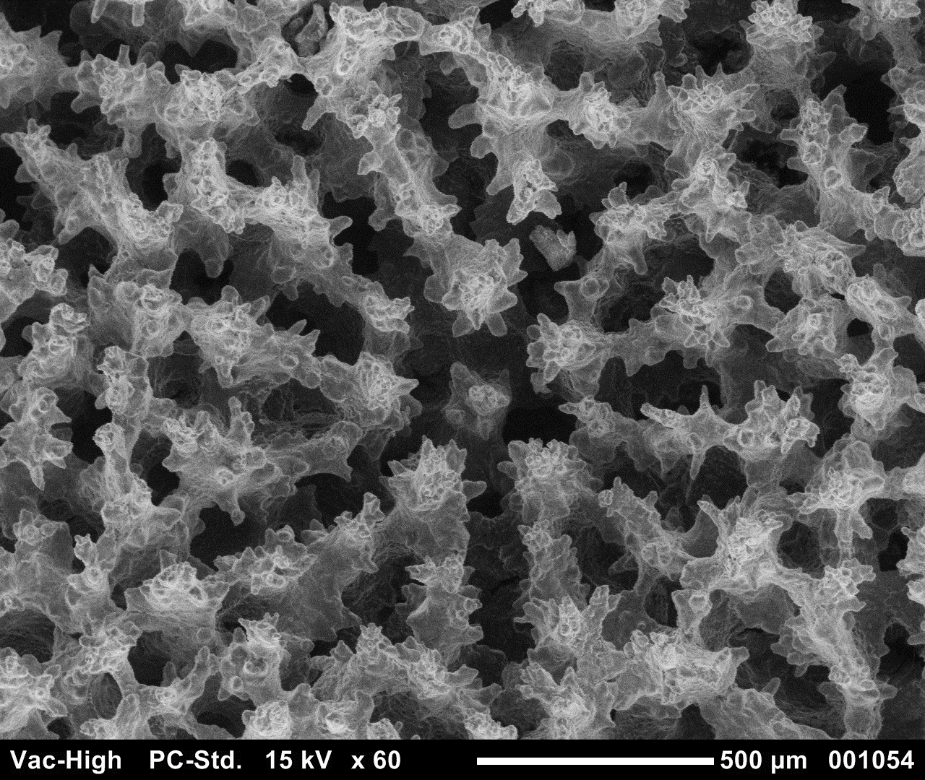
A
Coral Tissue (OA)
Turf Algae (OA)
B
Co
C
D
E
DSp
RS
Sp
DTr
Sp
Acropora
DCoe
DSep
Tr
Th
Sep
DTh
F
G
H
I
De
DCo
Co
Porites
Sp
RS
AN
Sep
DSp

Slide 20
A
Coral Tissue (OA)
Turf Algae (OA)
B
Co
C
D
E
DSp
RS
Sp
DTr
Sp
Acropora
DCoe
DSep
Tr
Th
Sep
DTh
F
G
H
I
De
DCo
Co
Porites
Sp
RS
AN
Sep
DSp

